Slide 1
INVESTMENT ASSIGNMENT SUBMISSION
Name: Devashish Pradeep Khairnar

Slide 2
Problem Statement and Objective
Spark Funds, being an asset management company wants to invest in the global market. Before making any investments the CEO wants to understand the trends of investments in the global market.
The goal here is to identify where most other investors are investing by identifying the best sector, the best country and the best investment type for making investment.
Business Constraints for investments:
Wants to invest between 5 to 15 million USD per round of investment.
Wants to invest only in English-speaking countries because of the ease of communication.
Data Available:
Company Details – The dataset contains the details about various companies along with their unique permalink.
Funding Round Details – The dataset contains the details regarding the funding received by various companies.

Slide 3
Strategy for Data Analysis
Investment Type Analysis
Country Analysis
Sector Analysis
Comparing the typical investment amounts in the various investment types
Identifying the countries which have been the most heavily invested in the past.
Understanding the distribution of investments across the eight main sectors.

Slide 4
Approach
Data Loading, Cleaning, and merging to get master data frame
Data Filtering Based on Investment Types
Applying Investment Constraints given by Spark Funds
Identifying the most suitable Investment Type for Spark Funds
Data Filtering to get Top3 English speaking countries' investment details
Create separate column having the primary sector from the category list
Using mapping information add separate column having the main sector
Create separate data frames for top 3 countries having all given constraints and main sector
Find out top three best sectors for top 3 countries
Plot insights using graphs and charts

Slide 5
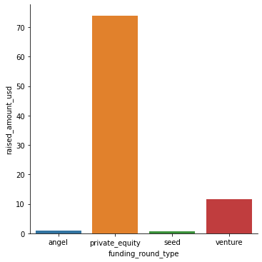
Investment Type Analysis
Business Condition:
Spark Fund wants to invest between 5 to 15 million USD.
As per the graph herewith, the observations are as follows:
Venture investment type is the most suitable one for the Spark Funds as it’s average investment falls under the range of 5 to 15 million USD.
Private Equity is a strong candidate but the range of investment falls par above the given range for Spark Funds.
Angel and Seed funding types have average investments below the 5 million USD
Average Invested Amount vs Investment Type

Slide 6
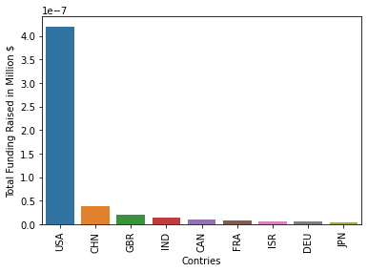
Country Analysis
Business Precondition:
Spark Fund wants to invest between 5 to 15 million USD
As per previous analysis most suitable FT is Venture
Spark Funds want to invest only in English speaking country
As per the graph herewith, the observations are as follows:
United States is the most suitable country for the investment as per the historical data
China is at the second position but not English speaking country
Great Britain and India are the second and third best countries for the investment respectively
United States have the total investments more than 107766 million USD and 12064 total investments
Total Funding Raised in Million USD vs Top 9 Countries

Slide 7
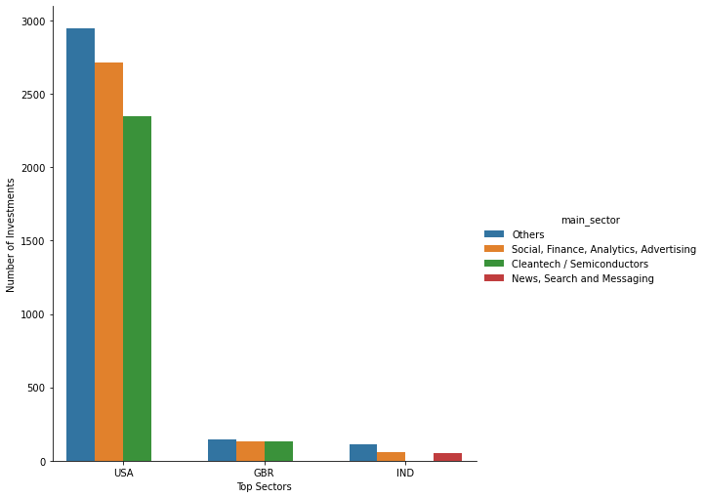
Sector Analysis
Business Preconditions:
Spark Fund wants to invest between 5 to 15 million USD
As per previous analysis most suitable FT is Venture
As per the graph herewith, the observations are as follows:
Others is the sector where most of the investors invested heavily
In USA and Britain, Others is the best sector, social, finance, Analytics, advertising is the second best and Cleantech/ Semiconductor is the third best sector
The similar trend can be observed in India but instead of Cleantech/ Semiconductor, News, Search and Messaging is the third best sector in India.

Slide 8
Conclusions
According to the business preconditions, Venture is the most suitable type of investment for Spark Funds.
USA is the best country for investment followed by Great Britain and India as 2nd and 3rd best option respectively.
Others is the best sector to invest followed by Social, Finance, Analytics, Advertising as the second best for investment in any top 3 countries.
Considering all the constraints and analysis, Virtustream is emerged as the best option for investment followed by Shotspotter in USA.
Electric-cloud is the best company to invest in Britain and Firstcry-com is the best company from India to invest.

